Slide 1
Tobacco
Products, Risks and Addictive Nature

Slide 2
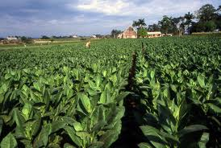
Tobacco Products
Tobacco
Plant that is used to make many products
Contains _____________
_______________ addictive drug in ______ tobacco products
Goes directly to the ________
Raises heart rate and blood pressure

Slide 3
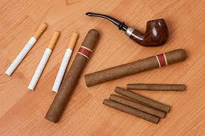
Tobacco Products cont.
Types
Cigarettes
________________-smoke
Smokeless tobacco
Chewing tobacco
Held between ____________ ________ ____________
Snuff
Snorted
Pipes
Smoke is held in the mouth
_____________
Smoke is held in the mouth

Slide 4
What Happens Psychologically
Within ________ ______________ nicotine enter bloodstream
Crosses protective barrier in brain
30 minutes after cigarette brain undergoes nicotine _________________
Brain adapts to nicotine by creating more nicotine receptors
Feels normal with nicotine, abnormal without
Within hours withdrwal symptoms start

Slide 5
What happens physically
Airway of lungs _______________
________________ lung function
Nagging cough and shortness of breath
Increased heart rate
Elevated blood pressure
Carbon monoxide deprives cells of _________
Exposes carcinogens to body tissues
When smoke touches a cell it is _____________

Slide 6
Harmful Chemicals in Tobacco Products
Added in order to
Keep tobacco ________
Make it ________ better
Help it _________
Over ___________ harmful chemicals
2 major dangerous chemicals
Carbon Monoxide
___________ that makes it hard for the blood to carry oxygen
Tar
Sticky substance that can ______________ the airways
Causes cancer
These ____________ are found in the air around the smokers

Slide 7
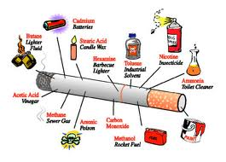
What’s in a cigarette?

Slide 8
Different Types of Tobacco Smoke
Mainstream Smoke
Smoke inhaled from the cigarette into the person’s lung
Sidestream Smoke
Smoke __________ _________ of a burning cigarette
Environmental Tobacco Smoke (ETS)
Mix of ___________ smoke and smoke from the ________ of lit cigarette
AKA: ________________ smoke
Causes _________ health problems to smokers and nonsmokers alike

Slide 9
How Tobacco Affects the Body
Brain
Causes _____________ of chemical in the brain that causes cravings
_____________ System
Heart
Causes atherosclerosis
Heart disease that leads to high blood pressure, heart attack and stroke
______________ System
Lungs
Smoke ___________ airways
Impairs lung function
Leads to other respiratory diseases
_______________ System
Skin and senses
Ages and ____________ the skin
Inhibits senses
________________ System

Slide 10
How Tobacco Affects the Body cont.
Stomach and colon
Can cause stomach ___________
Can cause colon cancer
____________ System
Bladder
Can cause kidney cancer
___________ Cancer
___________ System
Mouth, teeth, throat and fingers
Bad ___________
______________ teeth
Gum disease
Mouth, throat, esophageal __________
______________ fingers

Slide 11
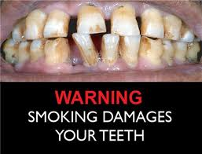
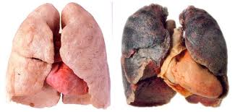
Physical Damages

Slide 12
Diseases Linked to Tobacco
Cancer
Abnormal cell growth
Most common cause of death from smokers
Chronic Bronchitis
Mucus ____________ the airways
“Smokers cough”
Respiratory infection
Colds
Pneumonia
Smoking _________ the body of ____________ ______
Emphysema
Air sacs in the lungs that become damaged
Body does not get _________
Responsible for 100,000 death per year
Asthma
Chronic ______________ when the air sacs become damaged
Smokes exposure in those that have ___________ can cause ____________ frequent and severe attacks

Slide 13
Why People Use Tobacco
Peer pressure
Family
_____ __________ more likely to be a smokers
Role models
Media
_________ of Americans DO NOT use tobacco products!!!
Not everyone is doing it!
Don’t start so you don’t have to quit!

Slide 14
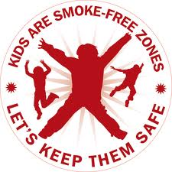
Being Tobacco Free
Reject any offers
“JUST SAY NO!”
___________ _________
Avoid Situations
Be a _________ model/leader
Stay true to your ___________ _______ ___________

